Slide 1
Planning

Slide 2
References:
Stuart Russel, Peter Norvig: Artificial Intelligence - A Modern Approach, 2nd Edition, Pearson Education, 2012.
Elaine Rich, Kevin Knight, Shivashankar B Nair: Artificial Intelligence, 3rd Edition, Tata McGraw Hill, 2011.
Nils J. Nilsson: Principles of Artificial Intelligence, First Edition, Elsevier, 2002.
Luger, G. F., & Stubblefield, W. A., Artificial Intelligence - Structures and Strategies for Complex Problem Solving. New York, NY: Addison Wesley, 5th edition (2005).
Acknowledgement:
All the recourses materials available on the Internet in the area of
Artificial Intelligence

Slide 3
Planning Agent
sensors
?
environment
agent
actuators
A1
A2
A3

Slide 4
Outline
The Planning problem
Planning with State-space search
Partial-order planning
Planning graphs
Planning with propositional logic
Analysis of planning approaches

Slide 5
Planning problem
Classical planning environment: fully observable, deterministic, finite, static and discrete.
Find a sequence of actions that achieves a given goal when executed from a given initial world state. That is, given
  a set of action descriptions (defining the possible primitive actions by the agent),
  an initial state description, and
  a goal state description or predicate,
compute a plan, which is
  a sequence of action instances, such that executing them in the initial state will change the world to a state satisfying the goal-state description.
Goals are usually specified as a conjunction of subgoals to be achieved

Slide 6
Planning vs. problem solving
Planning and problem solving methods can often solve the same sorts of problems
Planning is more powerful because of the representations and methods used
States, goals, and actions are decomposed into sets of sentences (usually in first-order logic)
Search often proceeds through plan space rather than state space (though first we will talk about state-space planners)
Subgoals can be planned independently, reducing the complexity of the planning problem

Slide 7
Goal of Planning
Choose actions to achieve a certain goal
But isn’t it exactly the same goal as for problem solving?
Some difficulties with problem solving:
  The successor function is a black box: it must be “applied” to a state to know which actions are possible in that state and what are the effects of each one
Suppose that the goal is HAVE(MILK).
From some initial state where HAVE(MILK) is not
satisfied, the successor function must be repeatedly
applied to eventually generate a state where
HAVE(MILK) is satisfied.
An explicit representation of the possible actions
and their effects would help the problem solver
select the relevant actions
Otherwise, in the real world an agent would
be overwhelmed by irrelevant actions

Slide 8
Goal of Planning
Choose actions to achieve a certain goal
But isn’t it exactly the same goal as for problem solving?
Some difficulties with problem solving:
  The goal test is another black-box function, states are domain-specific data structures, and heuristics must be supplied for each new problem
Suppose that the goal is HAVE(MILK)∧HAVE(BOOK)
Without an explicit representation of the goal, the
problem solver cannot know that a state where
HAVE(MILK) is already achieved is more promising
than a state where neither HAVE(MILK) nor
HAVE(BOOK) is achieved

Slide 9
Goal of Planning
Choose actions to achieve a certain goal
But isn’t it exactly the same goal as for problem solving?
Some difficulties with problem solving:
  The goal may consist of several nearly independent subgoals, but there is no way for the problem solver to know it
HAVE(MILK) and HAVE(BOOK) may be achieved by
two nearly independent sequences of actions

Slide 10
Representations in Planning
Planning opens up the black-boxes by using logic to represent:
  Actions
  States
  Goals
Problem solving
Logic representation
Planning

Slide 11
Major approaches
Situation calculus
State space planning
Partial order planning
Planning graphs
Planning with Propositional Logic
Hierarchical decomposition (HTN planning)
Reactive planning
Planning rapidly changing subfield of AI
In biannual competition at AI Planning Systems Conference:
  six years ago, best planner did plan space search using
  SAT solver
  four years ago, the best planner did regression search
  two years ago, best planner did forward state space search with
  an inadmissable heuristic function

Slide 12
Situation Calculus Planning
Formulate planning problem in FOL
Use theorem prover to find proof (aka plan)

Slide 13
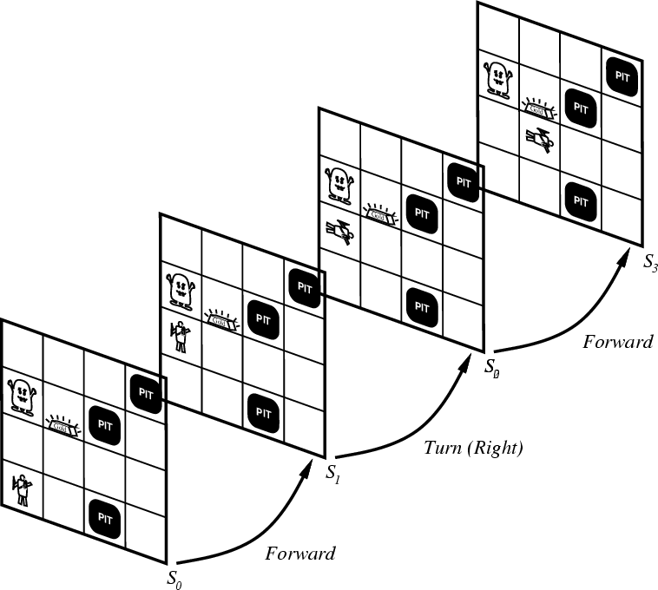
Representing change
Representing change in the world in logic can be tricky.
One way is just to change the KB
  Add and delete sentences from the KB to reflect changes
  How do we remember the past, or reason about changes?
Situation calculus is another way
A situation is a snapshot of the world at some instant in time
When the agent performs an action A in situation S1, the result is a new situation S2.

Slide 14
Situations

Slide 15
Situation calculus
A situation is a snapshot of the world at an interval of time during which nothing changes
Every true or false statement is made with respect to a particular situation.
  Add situation variables to every predicate.
  at(hunter,1,1) becomes at(hunter,1,1,s0): at(hunter,1,1) is true in situation (i.e., state) s0.
Add a new function, result(a,s), that maps a situation s into a new situation as a result of performing action a. For example, result(forward, s) is a function that returns the successor state (situation) to s
Example: The action agent-walks-to-location-y could be represented by
  (∀x)(∀y)(∀s) (at(Agent,x,s) ^ ~onbox(s)) -> at(Agent,y,result(walk(y),s))

Slide 16
Situation calculus planning
Initial state: a logical sentence about (situation) S₀
  At(Home, S₀) ^ ~Have(Milk, S₀) ^ ~ Have(Bananas, S₀) ^ ~Have(Drill, S₀)
Goal state:
  (∃s) At(Home,s) ^ Have(Milk,s) ^ Have(Bananas,s) ^ Have(Drill,s)
Operators are descriptions of actions:
  ∀(a,s) Have(Milk,Result(a,s)) <=> ((a=Buy(Milk) ^ At(Grocery,s)) ∨ (Have(Milk, s) ^ a~=Drop(Milk)))
Result(a,s) names the situation resulting from executing action a in situation s.
Action sequences are also useful: Result'(l,s) is the result of executing the list of actions (l) starting in s:
  (∀s) Result'([],s) = s
  (∀a,p,s) Result'([a|p]s) = Result'(p,Result(a,s))

Slide 17
Situation calculus planning II
A solution is thus a plan that when applied to the initial state yields a situation satisfying the goal query:
  At(Home,Result'(p,S₀))
  ^ Have(Milk,Result'(p,S₀))
  ^ Have(Bananas,Result'(p,S₀))
  ^ Have(Drill,Result'(p,S₀))
Thus we would expect a plan (i.e., variable assignment through unification) such as:
  p = [Go(Grocery), Buy(Milk), Buy(Bananas), Go(HardwareStore), Buy(Drill), Go(Home)]

Slide 18
SC planning: analysis
This is fine in theory, but remember that problem solving (search) is exponential in the worst case
Also, resolution theorem proving only finds a proof (plan), not necessarily a good plan
Another important issue: the Frame Problem

Slide 19
The Frame Problem
In SC, need not only axioms to describe what changes in each situation, but also need axioms to describe what stays the same (can do this using successor-state axioms)
Qualification problem: difficulty in specifying all the conditions that must hold in order for an action to work
Ramification problem: difficulty in specifying all of the effects that will hold after an action is taken

Slide 20
we restrict the language and use a special-purpose algorithm (a planner) rather than general theorem prover

Slide 21
Planning language
What is a good language?
  Expressive enough to describe a wide variety of problems.
  Restrictive enough to allow efficient algorithms to operate on it.
  Planning algorithm should be able to take advantage of the logical structure of the problem.
STRIPS and ADL

Slide 22
General language features
Representation of states
  Decompose the world in logical conditions and represent a state as a conjunction of positive literals.
    Propositional literals: Poor ∧ Unknown
    FO-literals (grounded and function-free): At(Plane1, Melbourne) ∧ At(Plane2, Sydney)
  Closed world assumption
Representation of goals
  Partially specified state and represented as a conjunction of positive ground literals
  A goal is satisfied if the state contains all literals in goal.

Slide 23
General language features
Representations of actions
  Action = PRECOND + EFFECT
    Action(Fly(p,from, to),
    PRECOND: At(p,from) ∧ Plane(p) ∧ Airport(from) ∧ Airport(to)
    EFFECT: ¬AT(p,from) ∧ At(p,to))
  = action schema (p, from, to need to be instantiated)
    Action name and parameter list
    Precondition (conj. of function-free literals)
    Effect (conj of function-free literals and P is True and not P is false)
  Add-list vs delete-list in Effect

Slide 24
Language semantics?
How do actions affect states?
  An action is applicable in any state that satisfies the precondition.
  For FO action schema applicability involves a substitution θ for the variables in the PRECOND.
    At(P1,JFK) ∧ At(P2,SFO) ∧ Plane(P1) ∧ Plane(P2) ∧ Airport(JFK) ∧ Airport(SFO)
    Satisfies : At(p,from) ∧ Plane(p) ∧ Airport(from) ∧ Airport(to)
    With θ ={p/P1,from/JFK,to/SFO}
    Thus the action is applicable.

Slide 25
Language semantics?
The result of executing action a in state s is the state s’
  s’ is same as s except
    Any positive literal P in the effect of a is added to s’
    Any negative literal ¬P is removed from s’
    EFFECT: ¬AT(p,from) ∧ At(p,to):
    At(P1,SFO) ∧ At(P2,SFO) ∧ Plane(P1) ∧ Plane(P2) ∧ Airport(JFK) ∧ Airport(SFO)
  STRIPS assumption: (avoids representational frame problem)
    every literal NOT in the effect remains unchanged

Slide 26
Expressiveness and extensions
STRIPS is simplified
  Important limit: function-free literals
    Allows for propositional representation
    Function symbols lead to infinitely many states and actions
Recent extension:Action Description language (ADL)
    Action(Fly(p:Plane, from: Airport, to: Airport),
    PRECOND: At(p,from) ∧ (from ≠ to)
    EFFECT: ¬At(p,from) ∧ At(p,to))
Standardization : Planning domain definition language (PDDL)

Slide 27
Blocks world
The blocks world is a micro-world that consists of a table, a set of blocks and a robot hand.
Some domain constraints:
  Only one block can be on another block
  Any number of blocks can be on the table
  The hand can only hold one block
Typical representation:
  ontable(a)
  ontable(c)
  on(b,a)
  handempty
  clear(b)
  clear(c)
B
A
C
TABLE

Slide 28
State Representation
C
A
B
TABLE
Conjunction of propositions:
BLOCK(A), BLOCK(B), BLOCK(C),
ON(A,TABLE), ON(B,TABLE), ON(C,A),
CLEAR(B), CLEAR(C), HANDEMPTY

Slide 29
Goal Representation
C
B
A
Conjunction of propositions:
ON(A,TABLE), ON(B,A), ON(C,B)
The goal G is achieved in a state S if all
the propositions in G are also in S

Slide 30
Action Representation
Unstack(x,y)
P = HANDEMPTY, BLOCK(x), BLOCK(y),
CLEAR(x), ON(x,y)
E = ¬HANDEMPTY, ¬CLEAR(x), HOLDING(x),
¬ ON(x,y), CLEAR(y)
Effect: list of literals
Precondition: conjunction of propositions
Means: Remove HANDEMPTY
from state
Means: Add
HOLDING(x) to state

Slide 31
Example
BLOCK(A), BLOCK(B), BLOCK(C),
ON(A,TABLE), ON(B,TABLE), ON(C,A),
CLEAR(B), CLEAR(C), HANDEMPTY
C
A
B
Unstack(C,A)
P = HANDEMPTY, BLOCK(C), BLOCK(A),
CLEAR(C), ON(C,A)
E = ¬HANDEMPTY, ¬CLEAR(C), HOLDING(C),
¬ ON(C,A), CLEAR(A)

Slide 32
Example
C
BLOCK(A), BLOCK(B), BLOCK(C),
ON(A,TABLE), ON(B,TABLE), ON(C,A),
CLEAR(B), CLEAR(C), HANDEMPTY,
HOLDING(C), CLEAR(A)
A
B
Unstack(C,A)
P = HANDEMPTY, BLOCK(C), BLOCK(A),
CLEAR(C), ON(C,A)
E = ¬HANDEMPTY, ¬CLEAR(C), HOLDING(C),
¬ ON(C,A), CLEAR(A)

Slide 33
Action Representation
Action(Unstack(x,y)
P: HANDEMPTY, BLOCK(x), BLOCK(y), CLEAR(x), ON(x,y)
E: ¬HANDEMPTY, ¬CLEAR(x), HOLDING(x), ¬ ON(x,y), CLEAR(y)
Action(Stack(x,y)
P: HOLDING(x), BLOCK(x), BLOCK(y), CLEAR(y)
E: ON(x,y), ¬CLEAR(y), ¬HOLDING(x), CLEAR(x), HANDEMPTY
Action(Pickup(x)
P: HANDEMPTY, BLOCK(x), CLEAR(x), ON(x,TABLE)
E: ¬HANDEMPTY, ¬CLEAR(x), HOLDING(x), ¬ON(x,TABLE)
Action(PutDown(x)
P: HOLDING(x)
E: ON(x,TABLE), ¬HOLDING(x), CLEAR(x), HANDEMPTY

Slide 34
Example: Blocks world (R&N version)
Init(On(A, Table) ∧ On(B,Table) ∧ On(C,Table) ∧ Block(A) ∧ Block(B) ∧ Block(C) ∧ Clear(A) ∧ Clear(B) ∧ Clear(C))
Goal(On(A,B) ∧ On(B,C))
Action(Move(b,x,y)
PRECOND: On(b,x) ∧ Clear(b) ∧ Clear(y) ∧ Block(b) ∧ (b≠ x) ∧ (b≠ y) ∧ (x≠ y)
EFFECT: On(b,y) ∧ Clear(x) ∧ ¬ On(b,x) ∧ ¬ Clear(y))
Action(MoveToTable(b,x)
PRECOND: On(b,x) ∧ Clear(b) ∧ Block(b) ∧ (b≠ x)
EFFECT: On(b,Table) ∧ Clear(x) ∧ ¬ On(b,x))
Spurious actions are possible: Move(B,C,C)

Slide 35
Example: air cargo transport
Init(At(C1, SFO) ∧ At(C2,JFK) ∧ At(P1,SFO) ∧ At(P2,JFK) ∧ Cargo(C1) ∧ Cargo(C2) ∧ Plane(P1) ∧ Plane(P2) ∧ Airport(JFK) ∧ Airport(SFO))
Goal(At(C1,JFK) ∧ At(C2,SFO))
Action(Load(c,p,a)
PRECOND: At(c,a) ∧At(p,a) ∧Cargo(c) ∧Plane(p) ∧Airport(a)
EFFECT: ¬At(c,a) ∧In(c,p))
Action(Unload(c,p,a)
PRECOND: In(c,p) ∧At(p,a) ∧Cargo(c) ∧Plane(p) ∧Airport(a)
EFFECT: At(c,a) ∧ ¬In(c,p))
Action(Fly(p,from,to)
PRECOND: At(p,from) ∧Plane(p) ∧Airport(from) ∧Airport(to)
EFFECT: ¬ At(p,from) ∧ At(p,to))
[Load(C1,P1,SFO), Fly(P1,SFO,JFK), Load(C2,P2,JFK), Fly(P2,JFK,SFO)]

Slide 36
Example: Spare tire problem
Init(At(Flat, Axle) ∧ At(Spare,trunk))
Goal(At(Spare,Axle))
Action(Remove(Spare,Trunk)
PRECOND: At(Spare,Trunk)
EFFECT: ¬At(Spare,Trunk) ∧ At(Spare,Ground))
Action(Remove(Flat,Axle)
PRECOND: At(Flat,Axle)
EFFECT: ¬At(Flat,Axle) ∧ At(Flat,Ground))
Action(PutOn(Spare,Axle)
PRECOND: At(Spare,Groundp) ∧¬At(Flat,Axle)
EFFECT: At(Spare,Axle) ∧ ¬At(Spare,Ground))
Action(LeaveOvernight
PRECOND:
EFFECT: ¬ At(Spare,Ground) ∧ ¬ At(Spare,Axle) ∧ ¬ At(Spare,trunk) ∧ ¬ At(Flat,Ground) ∧ ¬ At(Flat,Axle) )
This example goes beyond STRIPS: negative literal in pre-condition (ADL description)

Slide 37
Planning with state-space search
Both forward and backward search possible
Progression planners
  forward state-space search
  Consider the effect of all possible actions in a given state
Regression planners
  backward state-space search
  To achieve a goal, what must have been true in the previous state.

Slide 38
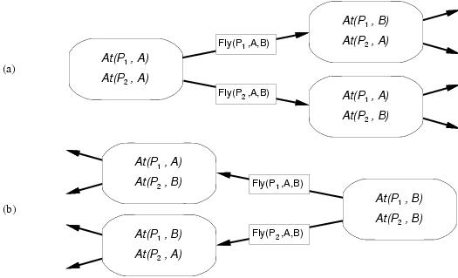
Progression and regression

Slide 39
Progression algorithm
Formulation as state-space search problem:
  Initial state = initial state of the planning problem
    Literals not appearing are false
  Actions = those whose preconditions are satisfied
    Add positive effects, delete negative
  Goal test = does the state satisfy the goal
  Step cost = each action costs 1
No functions … any graph search that is complete is a complete planning algorithm.
  E.g. A*
Inefficient:
  (1) irrelevant action problem
  (2) good heuristic required for efficient search

Slide 40
Regression algorithm
How to determine predecessors?
  What are the states from which applying a given action leads to the goal?
    Goal state = At(C1, B) ∧ At(C2, B) ∧ … ∧ At(C20, B)
    Relevant action for first conjunct: Unload(C1,p,B)
    Works only if pre-conditions are satisfied.
    Previous state= In(C1, p) ∧ At(p, B) ∧ At(C2, B) ∧ … ∧ At(C20, B)
    Subgoal At(C1,B) should not be present in this state.
Actions must not undo desired literals (consistent)
Main advantage: only relevant actions are considered.
  Often much lower branching factor than forward search.

Slide 41
Regression algorithm
General process for predecessor construction
  Give a goal description G
  Let A be an action that is relevant and consistent
  The predecessors is as follows:
    Any positive effects of A that appear in G are deleted.
    Each precondition literal of A is added , unless it already appears.
Any standard search algorithm can be added to perform the search.
Termination when predecessor satisfied by initial state.
  In FO case, satisfaction might require a substitution.

Slide 42
Heuristics for state-space search
Neither progression or regression are very efficient without a good heuristic.
  How many actions are needed to achieve the goal?
  Exact solution is NP hard, find a good estimate
Two approaches to find admissible heuristic:
  The optimal solution to the relaxed problem.
    Remove all preconditions from actions
  The subgoal independence assumption:
    The cost of solving a conjunction of subgoals is approximated by the sum of the costs of solving the subproblems independently.

Slide 43
Partial-order planning
Progression and regression planning are totally ordered plan search forms.
  They cannot take advantage of problem decomposition.
    Decisions must be made on how to sequence actions on all the subproblems
Least commitment strategy:
  Delay choice during search

Slide 44
Shoe example
Goal(RightShoeOn ∧ LeftShoeOn)
Init()
Action(RightShoe, PRECOND: RightSockOn
EFFECT: RightShoeOn)
Action(RightSock, PRECOND:
EFFECT: RightSockOn)
Action(LeftShoe, PRECOND: LeftSockOn
EFFECT: LeftShoeOn)
Action(LeftSock, PRECOND:
EFFECT: LeftSockOn)
Planner: combine two action sequences (1)leftsock, leftshoe (2)rightsock, rightshoe

Slide 45
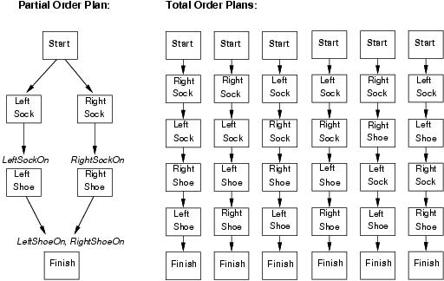
Partial-order planning(POP)
Any planning algorithm that can place two actions into a plan without which comes first is a PO plan.

Slide 46

POP as a search problem
States are (mostly unfinished) plans.
  The empty plan contains only start and finish actions.
Each plan has 4 components:
  A set of actions (steps of the plan)
  A set of ordering constraints: A < B (A before B)
    Cycles represent contradictions.
  A set of causal links
    The plan may not be extended by adding a new action C that conflicts with the causal link. (if the effect of C is ¬p and if C could come after A and before B)
  A set of open preconditions.
    If precondition is not achieved by action in the plan.

Slide 47
Example of final plan
Actions={Rightsock, Rightshoe, Leftsock, Leftshoe, Start, Finish}
Orderings={Rightsock < Rightshoe; Leftsock < Leftshoe}
Links={Rightsock->Rightsockon -> Rightshoe, Leftsock->Leftsockon-> Leftshoe, Rightshoe->Rightshoeon->Finish, …}
Open preconditions={}

Slide 48
POP as a search problem
A plan is consistent iff there are no cycles in the ordering constraints and no conflicts with the causal links.
A consistent plan with no open preconditions is a solution.
A partial order plan is executed by repeatedly choosing any of the possible next actions.
  This flexibility is a benefit in non-cooperative environments.

Slide 49
Solving POP
Assume propositional planning problems:
  The initial plan contains Start and Finish, the ordering constraint Start < Finish, no causal links, all the preconditions in Finish are open.
  Successor function :
    picks one open precondition p on an action B and
    generates a successor plan for every possible consistent way of choosing action A that achieves p.
  Test goal

Slide 50
Enforcing consistency
When generating successor plan:
  The causal link A->p->B and the ordering constraint A < B is added to the plan.
    If A is new also add start < A and A < B to the plan
  Resolve conflicts between new causal link and all existing actions
  Resolve conflicts between action A (if new) and all existing causal links.

Slide 51
Process summary
Operators on partial plans
  Add link from existing plan to open precondition.
  Add a step to fulfill an open condition.
  Order one step w.r.t another to remove possible conflicts
Gradually move from incomplete/vague plans to complete/correct plans
Backtrack if an open condition is unachievable or if a conflict is irresolvable.

Slide 52
Example: Spare tire problem
Init(At(Flat, Axle) ∧ At(Spare,trunk))
Goal(At(Spare,Axle))
Action(Remove(Spare,Trunk)
PRECOND: At(Spare,Trunk)
EFFECT: ¬At(Spare,Trunk) ∧ At(Spare,Ground))
Action(Remove(Flat,Axle)
PRECOND: At(Flat,Axle)
EFFECT: ¬At(Flat,Axle) ∧ At(Flat,Ground))
Action(PutOn(Spare,Axle)
PRECOND: At(Spare,Groundp) ∧¬At(Flat,Axle)
EFFECT: At(Spare,Axle) ∧ ¬Ar(Spare,Ground))
Action(LeaveOvernight
PRECOND:
EFFECT: ¬ At(Spare,Ground) ∧ ¬ At(Spare,Axle) ∧ ¬ At(Spare,trunk) ∧ ¬ At(Flat,Ground) ∧ ¬ At(Flat,Axle) )

Slide 53

Solving the problem
Initial plan: Start with EFFECTS and Finish with PRECOND.

Slide 54
Solving the problem
Initial plan: Start with EFFECTS and Finish with PRECOND.
Pick an open precondition: At(Spare, Axle)
Only PutOn(Spare, Axle) is applicable
Add causal link:
Add constraint : PutOn(Spare, Axle) < Finish

Slide 55
Solving the problem
Pick an open precondition: At(Spare, Ground)
Only Remove(Spare, Trunk) is applicable
Add causal link:
Add constraint : Remove(Spare, Trunk) < PutOn(Spare,Axle)

Slide 56
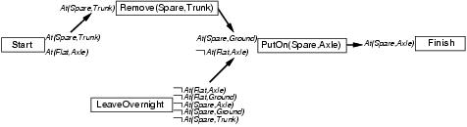
Solving the problem
Pick an open precondition: ¬At(Flat, Axle)
LeaveOverNight is applicable
conflict: LeaveOverNight also has the effect ¬ At(Spare,Ground)
To resolve, add constraint : LeaveOverNight < Remove(Spare, Trunk)

Slide 57
Solving the problem
Pick an open precondition: At(Spare, Trunk)
Only Start is applicable
Add causal link:
Conflict: of causal link with effect At(Spare,Trunk) in LeaveOverNight
  No re-ordering solution possible.
backtrack

Slide 58

Solving the problem
Remove LeaveOverNight and causal links
Add RemoveFlatAxle and finish

Slide 59
Some details …
What happens when a first-order representation that includes variables is used?
  Complicates the process of detecting and resolving conflicts.
  Can be resolved by introducing inequality constraint.
CSP’s most-constrained-variable constraint can be used for planning algorithms to select a PRECOND.

Slide 60
Planning graphs
Used to achieve better heuristic estimates.
  A solution can also directly extracted using GRAPHPLAN.
Consists of a sequence of levels that correspond to time steps in the plan.
  Level 0 is the initial state.
  Each level consists of a set of literals and a set of actions.
    Literals = all those that could be true at that time step, depending upon the actions executed at the preceding time step.
    Actions = all those actions that could have their preconditions satisfied at that time step, depending on which of the literals actually hold.

Slide 61
Planning graphs
“Could”?
  Records only a restricted subset of possible negative interactions among actions.
They work only for propositional problems.
Example:
    Init(Have(Cake))
    Goal(Have(Cake) ∧ Eaten(Cake))
    Action(Eat(Cake), PRECOND: Have(Cake)
    EFFECT: ¬Have(Cake) ∧ Eaten(Cake))
    Action(Bake(Cake), PRECOND: ¬ Have(Cake)
    EFFECT: Have(Cake))

Slide 62
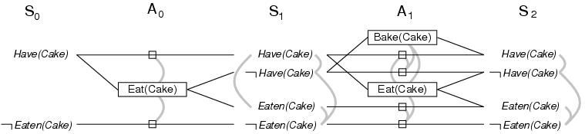
Cake example
Start at level S0 and determine action level A0 and next level S1.
  A0 >> all actions whose preconditions are satisfied in the previous level.
  Connect precond and effect of actions S0 --> S1
  Inaction is represented by persistence actions.
Level A0 contains the actions that could occur
  Conflicts between actions are represented by mutex links

Slide 63
Cake example
Level S1 contains all literals that could result from picking any subset of actions in A0
  Conflicts between literals that can not occur together (as a consequence of the selection action) are represented by mutex links.
  S1 defines multiple states and the mutex links are the constraints that define this set of states.
Continue until two consecutive levels are identical: leveled off
  Or contain the same amount of literals (explanation follows later)

Slide 64
Cake example
A mutex relation holds between two actions when:
  Inconsistent effects: one action negates the effect of another.
  Interference: one of the effects of one action is the negation of a precondition of the other.
  Competing needs: one of the preconditions of one action is mutually exclusive with the precondition of the other.
A mutex relation holds between two literals when (inconsistent support):
  If one is the negation of the other OR
  if each possible action pair that could achieve the literals is mutex.

Slide 65
PG and heuristic estimation
PG’s provide information about the problem
  A literal that does not appear in the final level of the graph cannot be achieved by any plan.
    Useful for backward search (cost = inf).
  Level of appearance can be used as cost estimate of achieving any goal literals = level cost.
  Small problem: several actions can occur
    Restrict to one action using serial PG (add mutex links between every pair of actions, except persistence actions).
  Cost of a conjunction of goals? Max-level, sum-level and set-level heuristics.
PG is a relaxed problem.

Slide 66
The GRAPHPLAN Algorithm
How to extract a solution directly from the PG
function GRAPHPLAN(problem) return solution or failure
graph ← INITIAL-PLANNING-GRAPH(problem)
goals ← GOALS[problem]
loop do
if goals all non-mutex in last level of graph then do
solution ← EXTRACT-SOLUTION(graph, goals, LENGTH(graph))
if solution ≠ failure then return solution
else if NO-SOLUTION-POSSIBLE(graph) then return failure
graph ← EXPAND-GRAPH(graph, problem)

Slide 67
Example: Spare tire problem
Init(At(Flat, Axle) ∧ At(Spare,trunk))
Goal(At(Spare,Axle))
Action(Remove(Spare,Trunk)
PRECOND: At(Spare,Trunk)
EFFECT: ¬At(Spare,Trunk) ∧ At(Spare,Ground))
Action(Remove(Flat,Axle)
PRECOND: At(Flat,Axle)
EFFECT: ¬At(Flat,Axle) ∧ At(Flat,Ground))
Action(PutOn(Spare,Axle)
PRECOND: At(Spare,Groundp) ∧¬At(Flat,Axle)
EFFECT: At(Spare,Axle) ∧ ¬At(Spare,Ground))
Action(LeaveOvernight
PRECOND:
EFFECT: ¬ At(Spare,Ground) ∧ ¬ At(Spare,Axle) ∧ ¬ At(Spare,trunk) ∧ ¬ At(Flat,Ground) ∧ ¬ At(Flat,Axle) )
This example goes beyond STRIPS: negative literal in pre-condition (ADL description)

Slide 68
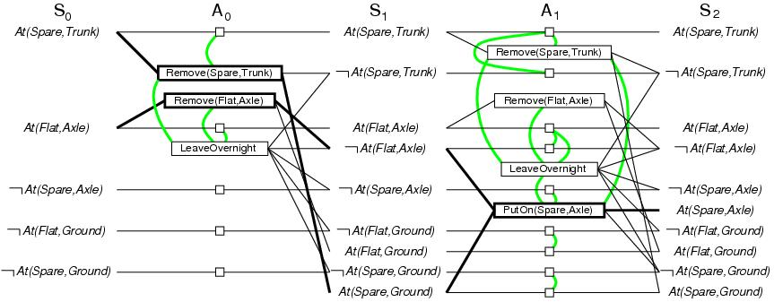
GRAPHPLAN example
Initially the plan consist of 5 literals from the initial state and the CWA literals (S0).
Add actions whose preconditions are satisfied by EXPAND-GRAPH (A0)
Also add persistence actions and mutex relations.
Add the effects at level S1
Repeat until goal is in level Si

Slide 69
GRAPHPLAN example
EXPAND-GRAPH also looks for mutex relations
  Inconsistent effects
    E.g. Remove(Spare, Trunk) and LeaveOverNight due to At(Spare,Ground) and not At(Spare, Ground)
  Interference
    E.g. Remove(Flat, Axle) and LeaveOverNight At(Flat, Axle) as PRECOND and not At(Flat,Axle) as EFFECT
  Competing needs
    E.g. PutOn(Spare,Axle) and Remove(Flat, Axle) due to At(Flat.Axle) and not At(Flat, Axle)
  Inconsistent support
    E.g. in S2, At(Spare,Axle) and At(Flat,Axle)

Slide 70
GRAPHPLAN example
In S2, the goal literals exist and are not mutex with any other
  Solution might exist and EXTRACT-SOLUTION will try to find it
EXTRACT-SOLUTION can use Boolean CSP to solve the problem or a search process:
  Initial state = last level of PG and goal goals of planning problem
  Actions = select any set of non-conflicting actions that cover the goals in the state
  Goal = reach level S0 such that all goals are satisfied
  Cost = 1 for each action.

Slide 71
GRAPHPLAN example
Termination? YES
PG are monotonically increasing or decreasing:
  Literals increase monotonically
  Actions increase monotonically
  Mutexes decrease monotonically
Because of these properties and because there is a finite number of actions and literals, every PG will eventually level off !

Slide 72
Planning with propositional logic
Planning can be done by proving theorem in situation calculus.
Here: test the satisfiability of a logical sentence:
Sentence contains propositions for every action occurrence.
  A model will assign true to the actions that are part of the correct plan and false to the others
  An assignment that corresponds to an incorrect plan will not be a model because of inconsistency with the assertion that the goal is true.
  If the planning is unsolvable the sentence will be unsatisfiable.

Slide 73
SATPLAN algorithm
function SATPLAN(problem, T_{max}) return solution or failure
inputs: problem, a planning problem
T_{max}, an upper limit to the plan length
for T= 0 to T_{max} do
cnf, mapping ← TRANSLATE-TO_SAT(problem, T)
assignment ← SAT-SOLVER(cnf)
if assignment is not null then
return EXTRACT-SOLUTION(assignment, mapping)
return failure

Slide 74
cnf, mapping ← TRANSLATE-TO_SAT(problem, T)
Distinct propositions for assertions about each time step.
  Superscripts denote the time step
    At(P1,SFO)⁰ ∧ At(P2,JFK)⁰
  No CWA thus specify which propositions are not true
    ¬At(P1,SFO)⁰ ∧ ¬At(P2,JFK)⁰
  Unknown propositions are left unspecified.
The goal is associated with a particular time-step
  But which one?

Slide 75
cnf, mapping ← TRANSLATE-TO_SAT(problem, T)
How to determine the time step where the goal will be reached?
  Start at T=0
    Assert At(P1,SFO)⁰ ∧ At(P2,JFK)⁰
  Failure .. Try T=1
    Assert At(P1,SFO)¹ ∧ At(P2,JFK)¹
  …
  Repeat this until some minimal path length is reached.
  Termination is ensured by T_{max}

Slide 76
cnf, mapping ← TRANSLATE-TO_SAT(problem, T)
How to encode actions into PL?
  Propositional versions of successor-state axioms
    At(P1,JFK)¹ ⇔
    (At(P1,JFK)⁰ ∧ ¬(Fly(P1,JFK,SFO)⁰ ∧ At(P1,JFK)⁰))∨ (Fly(P1,SFO,JFK)⁰ ∧ At(P1,SFO)⁰)
  Such an axiom is required for each plane, airport and time step
  If more airports add another way to travel than additional disjuncts are required
Once all these axioms are in place, the satisfiability algorithm can start to find a plan.

Slide 77
assignment ← SAT-SOLVER(cnf)
Multiple models can be found
They are NOT satisfactory: (for T=1)
    Fly(P1,SFO,JFK)⁰ ∧ Fly(P1,JFK,SFO)⁰ ∧ Fly(P2,JFK.SFO)⁰
    The second action is infeasible
    Yet the plan IS a model of the sentence
Avoiding illegal actions: pre-condition axioms
    Fly(P1,SFO,JFK)⁰ ⇒ At(P1,JFK)
Exactly one model now satisfies all the axioms where the goal is achieved at T=1.

Slide 78
assignment ← SAT-SOLVER(cnf)
A plane can fly at two destinations at once
They are NOT satisfactory: (for T=1)
    Fly(P1,SFO,JFK)⁰ ∧ Fly(P2,JFK,SFO)⁰ ∧ Fly(P2,JFK.LAX)⁰
    The second action is infeasible
    Yet the plan allows spurious relations
Avoid spurious solutions: action-exclusion axioms
    ¬(Fly(P2,JFK,SFO)⁰ ∧ Fly(P2,JFK,LAX))
  Prevents simultaneous actions
Lost of flexibility since plan becomes totally ordered : no actions are allowed to occur at the same time.
  Restrict exclusion to preconditions

Slide 79
Analysis of planning approach
Planning is an area of great interest within AI
  Search for solution
  Constructively prove a existence of solution
Biggest problem is the combinatorial explosion in states.
Efficient methods are under research
  E.g. divide-and-conquer

Slide 80
Planning Summary
The Planning problem
Planning with State-space search
Partial-order planning
Planning graphs
Planning with propositional logic
Analysis of planning approaches

Slide 81
Reference and Acknowledgement
[1] Russell and Norvig: Chapter 11

